Slide 1


E-Dairy System
Presented By-
Eknath A. Zaware(229149)
Akshay E. Gaikwad(229126)

Slide 2
INSTITUTE FOR ADVANCED COMPUTING AND SOFTWARE DEVELOPMENT AKURDI, PUNE
Documentation On
“EDairy System”
PG-DAC March 2023
Submitted By:
Group No: 54
Mr. Rohit Puranik Mrs. Geeta Darunte
Centre Coordinator Project Guide

Slide 3
Project Introduction
The E-Dairy System project is a collaborative effort to create a secure online platform to provide the helpful fresh,pure Dairy Products to the users or customers at doorstep.The E-Dairy System project will allow product providers to list their products on an online application and to accept the payment directly from the users or customers. This will help the users/customers to get real taste of the products which are available on the application.

Slide 4
Objective (Purpose):
The online Dairy System for Dairy products Web Application is intended to provide complete solution for vendors.
It will enable vendors to setup up online shops, customers to browse through virtual shop and purchase Dairy products online without visiting the shop physically.

Slide 5
Scope:
Online E-Dairy System is a web application.
The scope of E-Dairy System would include designing and developing a digital platform that allows customers/users.
This System allows Admins to maintain thier Dairy products for adding or removing from catalog based on their availablity.
The System will be able to show live Bussion Operation statistics trends through Customized dashboard for stakeholders.

Slide 6
Technology Used:
Front End: ReactJS
Back End: Java Spring Boot API.
Database: MySQL

Slide 7
S/W and H/W Requirements
Server Side:
Processor: Intel core i5 or above
HDD: 500 GB or above
RAM: 4GB or above
Database: MySQL
Client Side (minimum requirement):
Processor: Intel Dual Core
HDD: Minimum 80GB Disk Space
RAM: Minimum 2GB
OS: Windows 7, Linux

Slide 8
Functionalities - Module wise /user wise
Online Mess Service Portal consists of three modules named below
1. Admin
2. Customer/User
User Roles:
Admin : Admin can login to the system.
Admin:login,add services,add services details, update services.
Customer : register itself, logins ,update her/his details,view products,bye products.

Slide 9
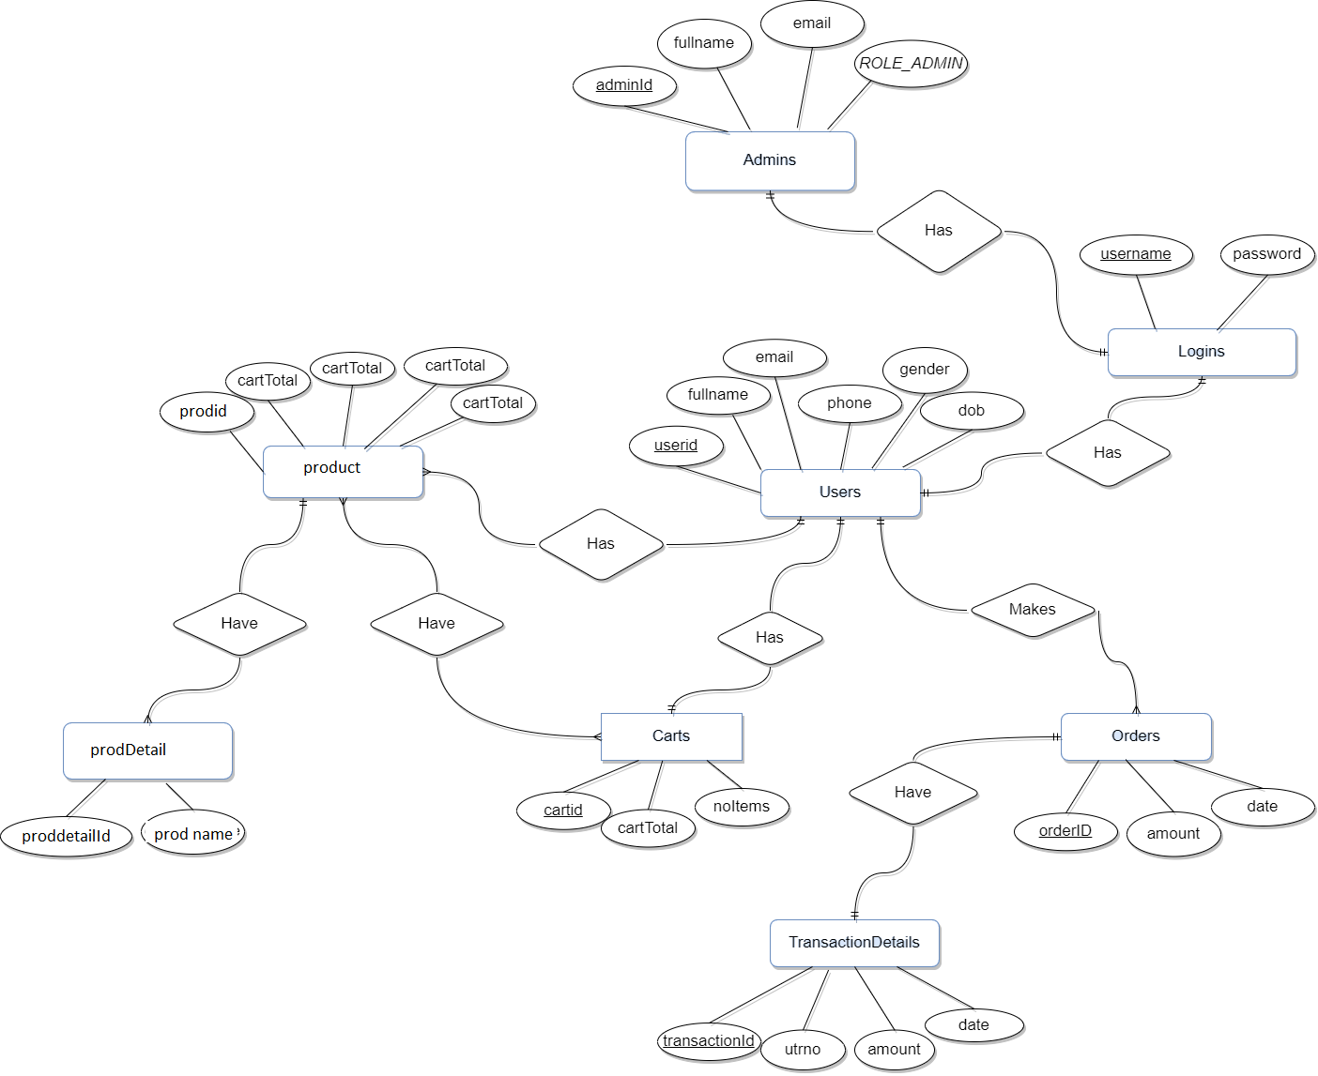
UML Diagrams: 1. E-R Diagram

Slide 10
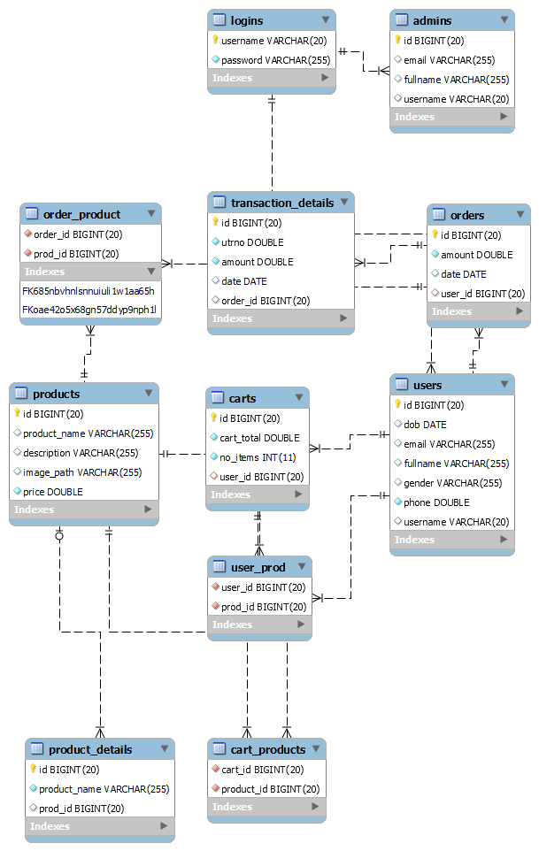
2.Class Diagram(MySQL Auto generated)

Slide 11
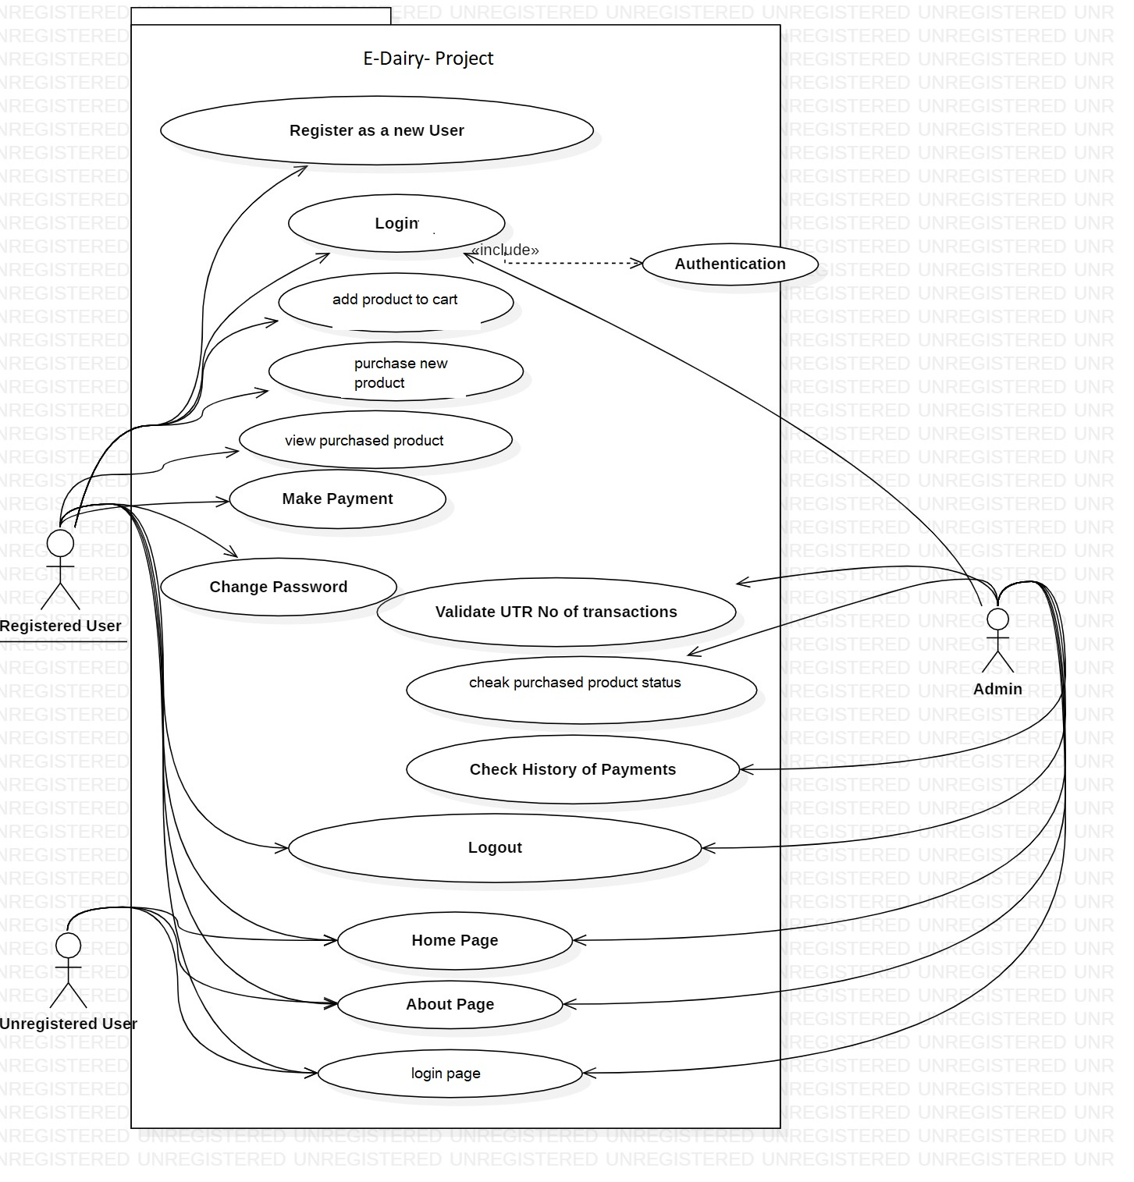
3.Use Case-

Slide 12
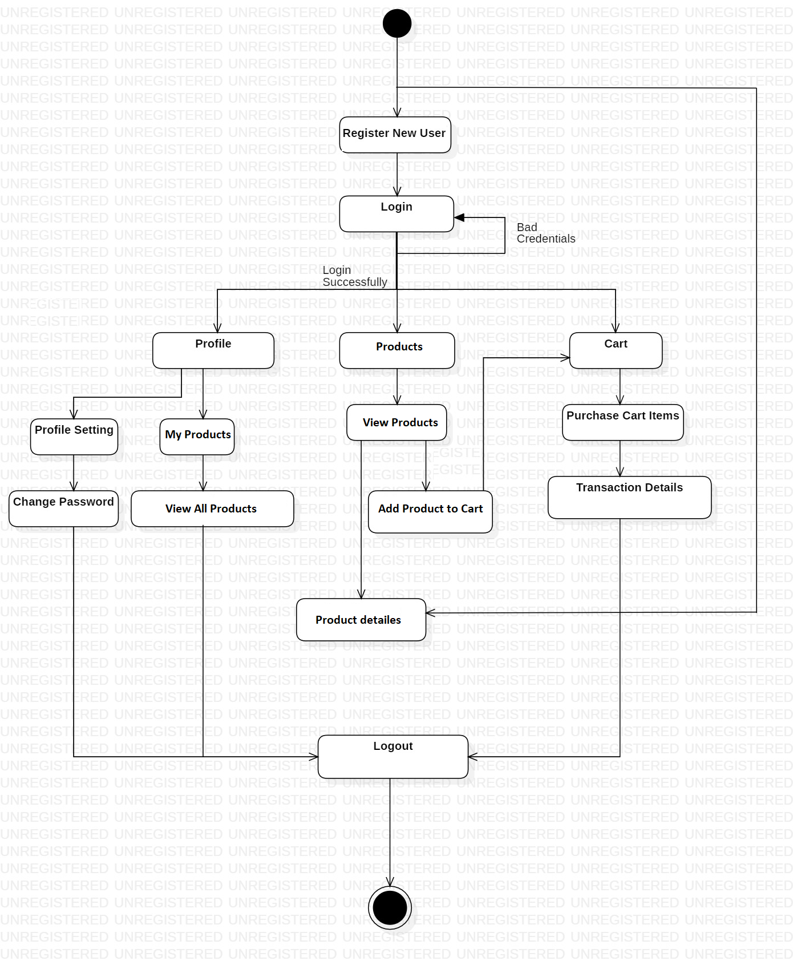
4.Activity Diagram Of User-

Slide 13
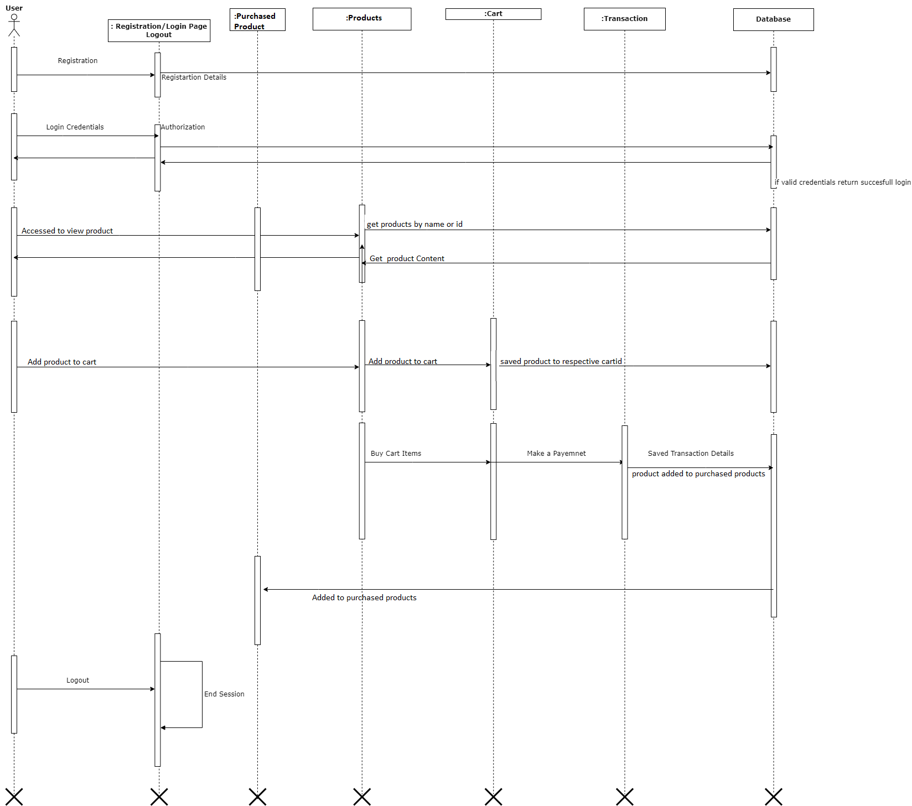
5.sequence diagram for login

Slide 14
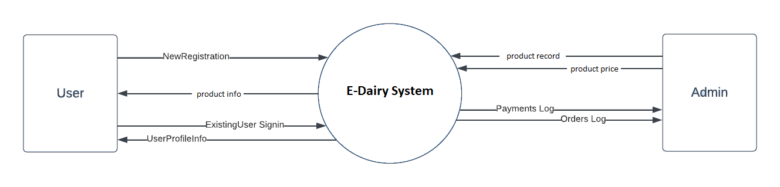
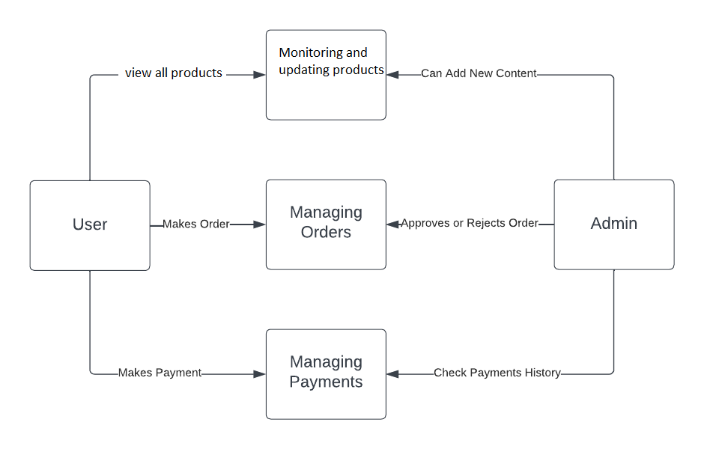
DFD diagrams

Slide 15
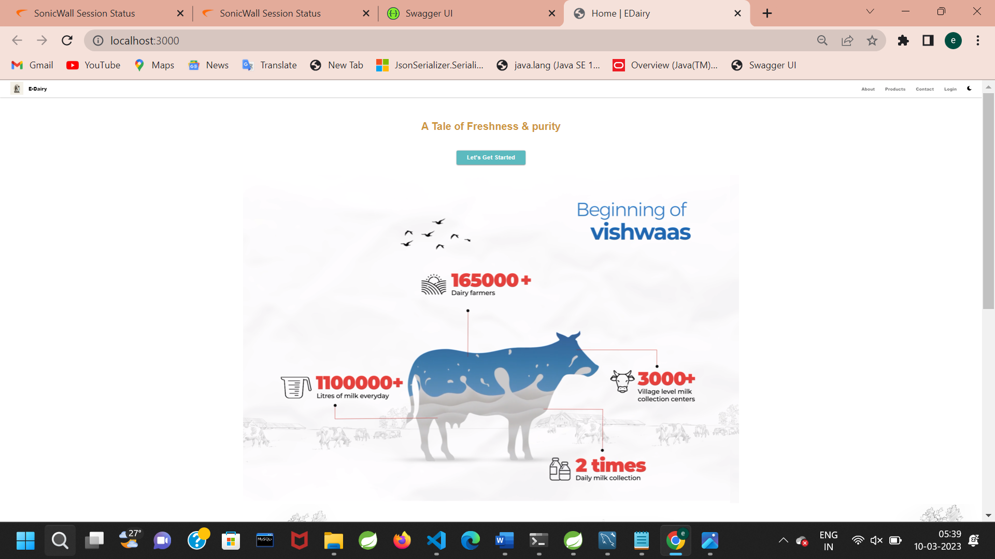
UI Screen Shots

Slide 16
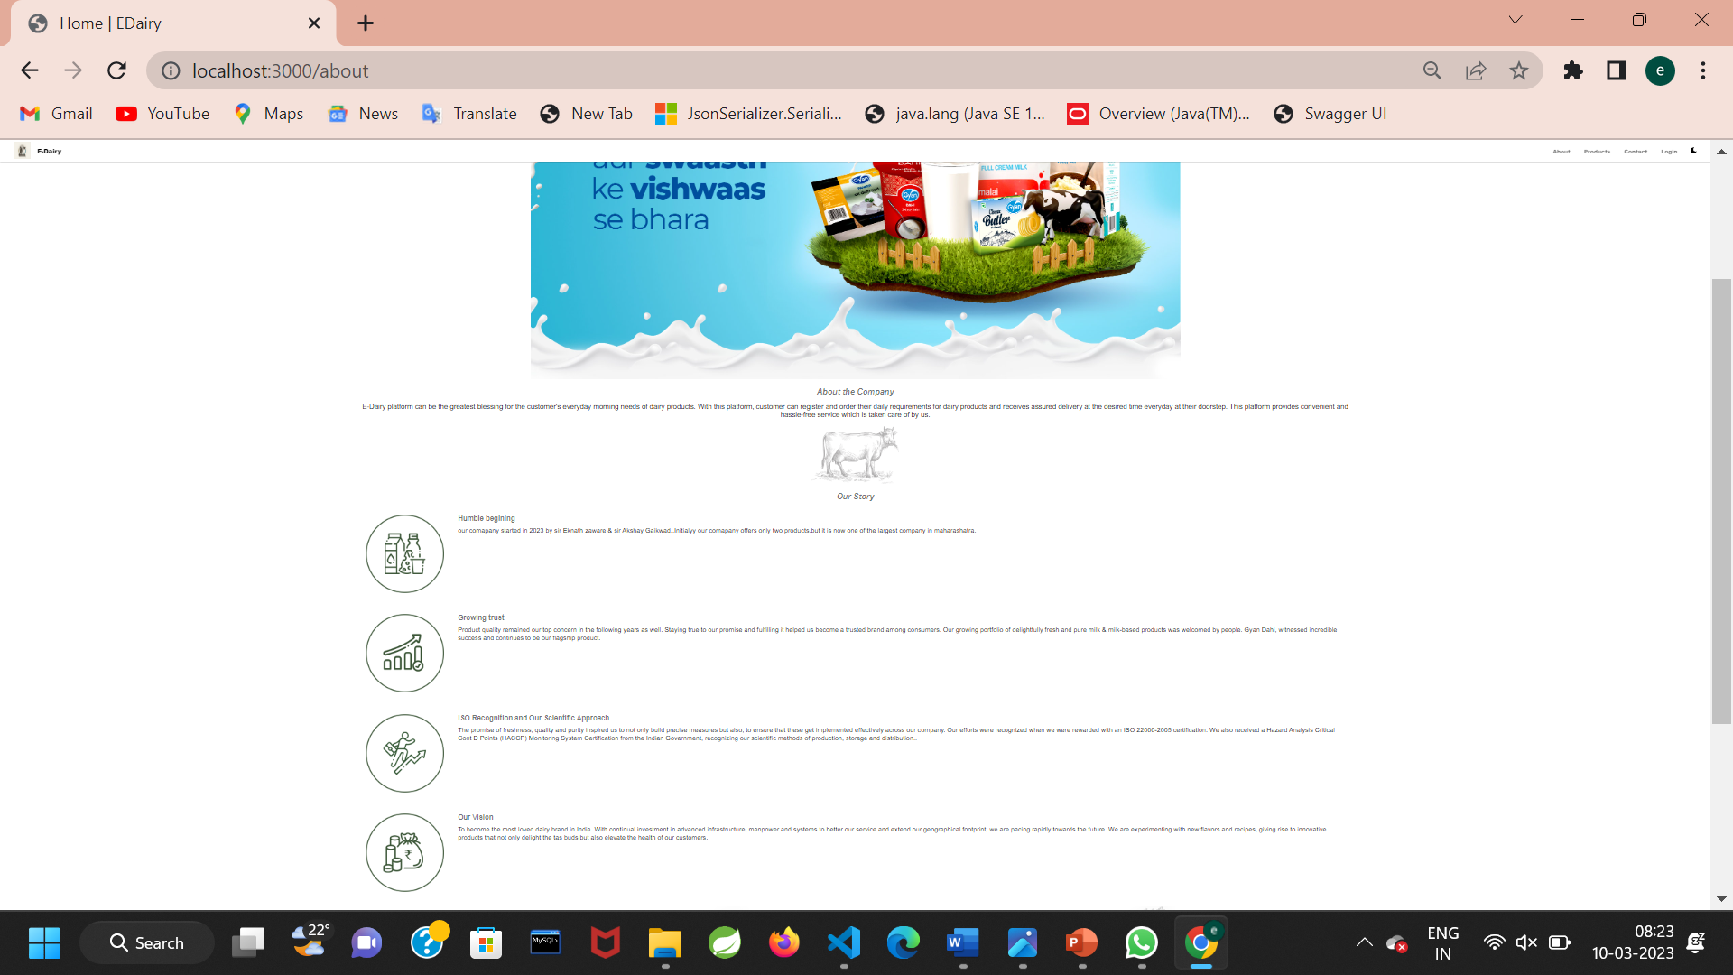

Slide 17
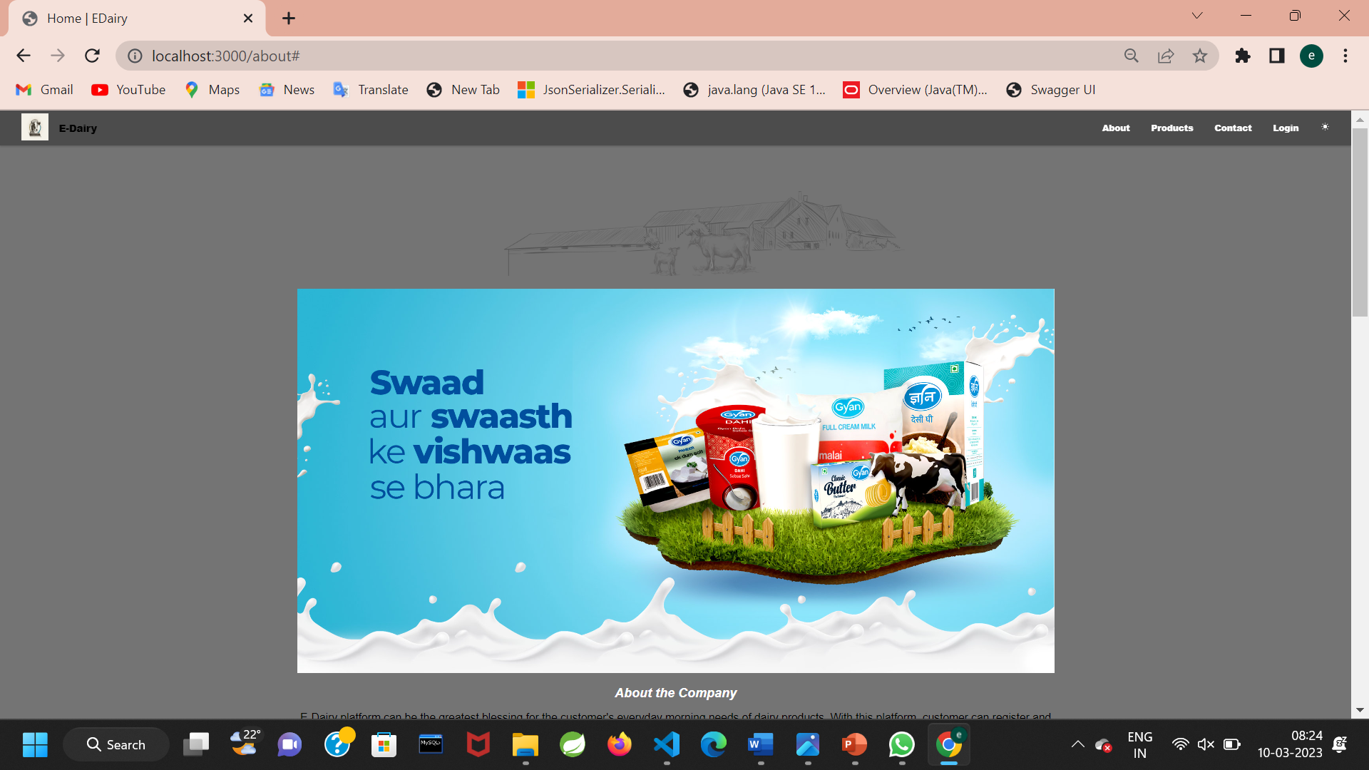

Slide 18
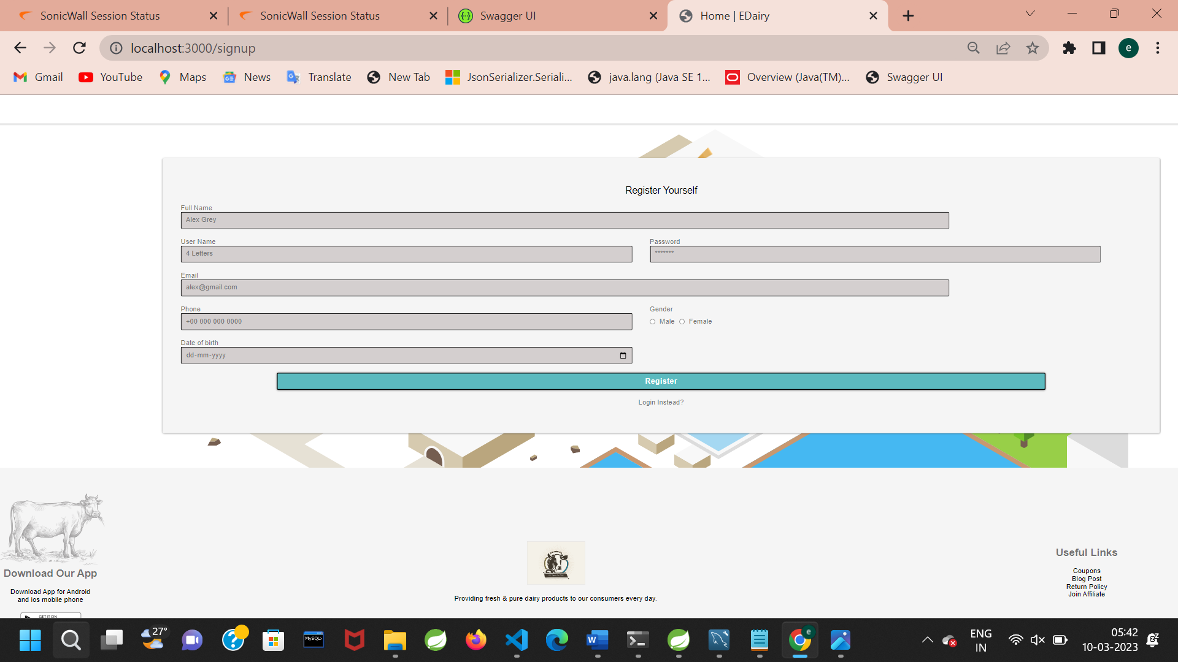

Slide 19
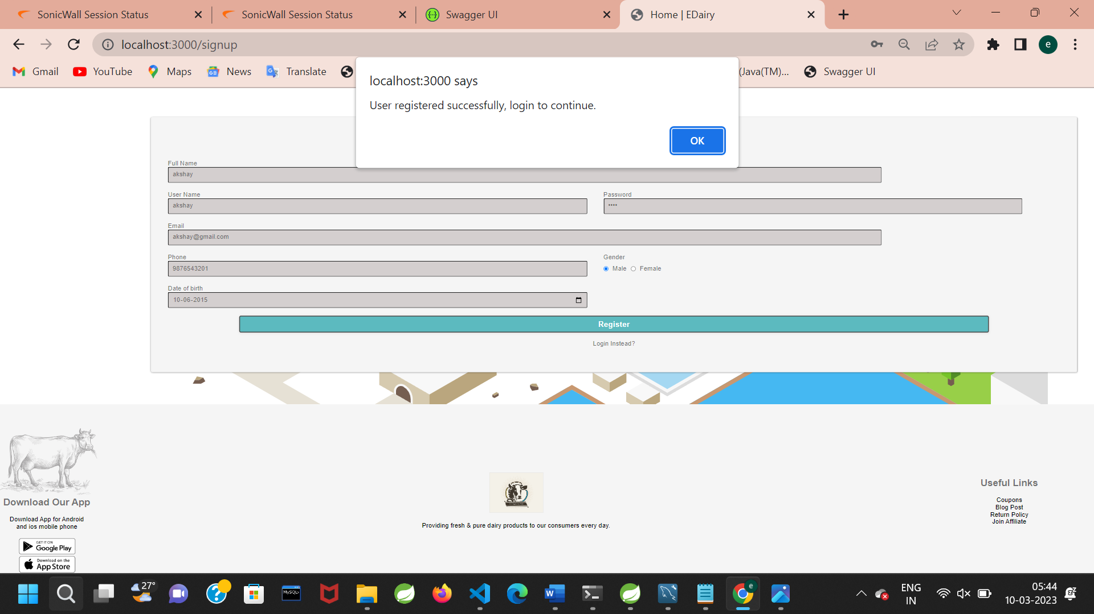

Slide 20
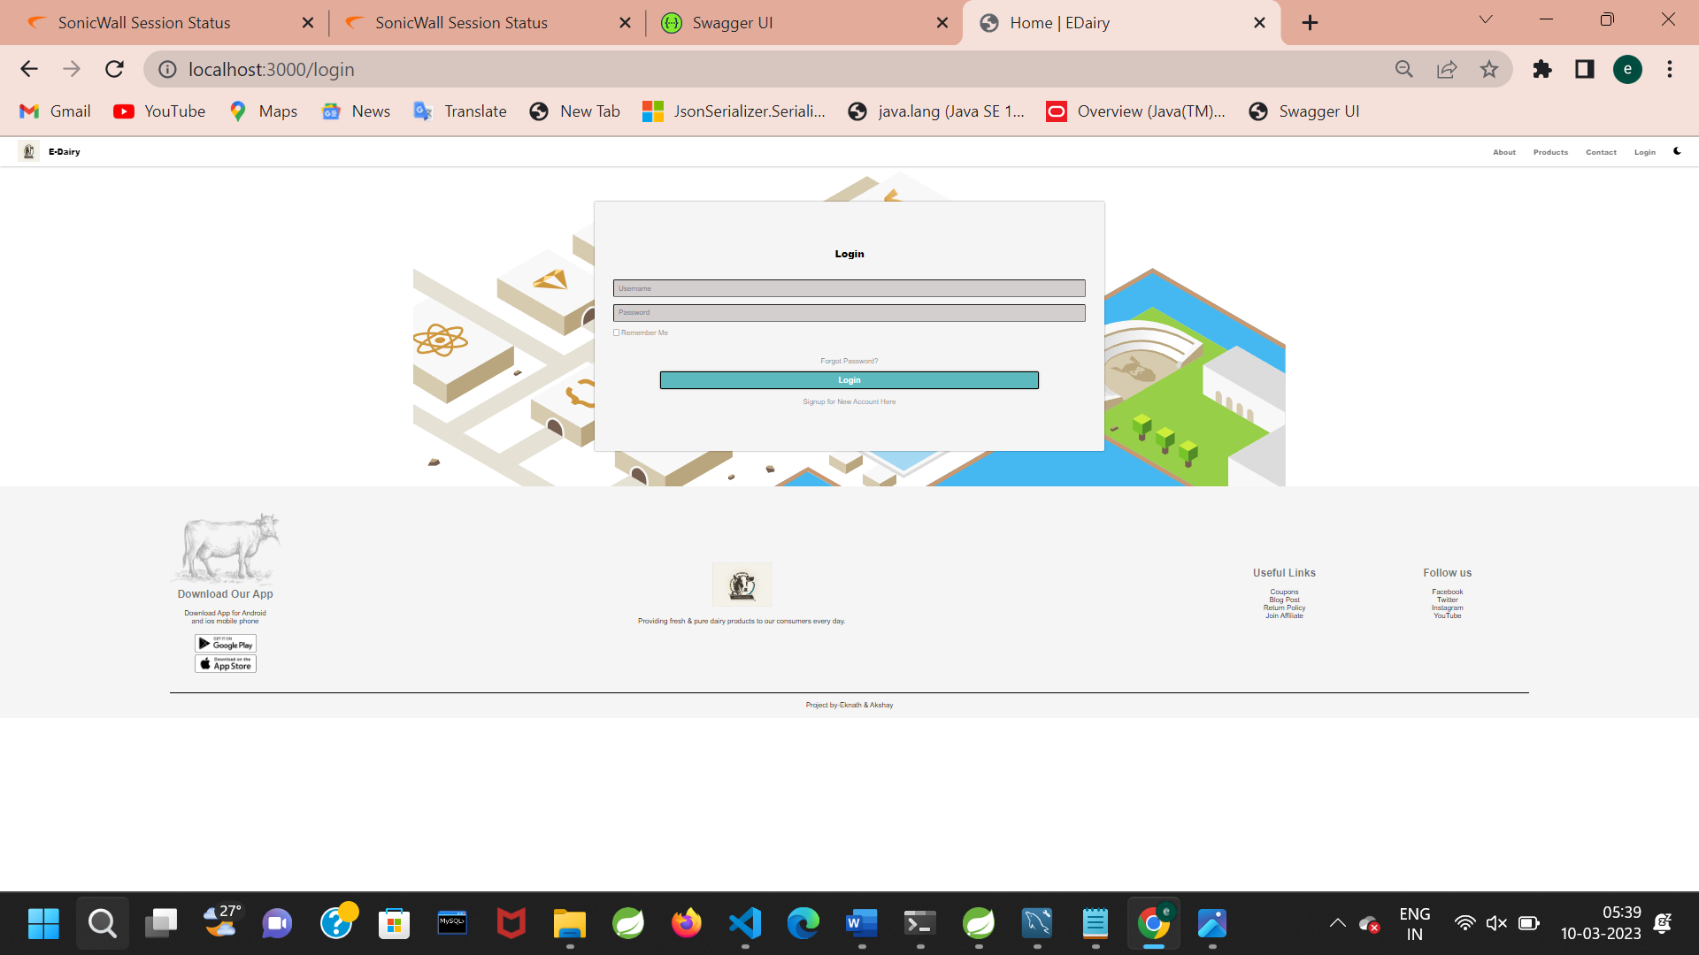

Slide 21


Slide 22
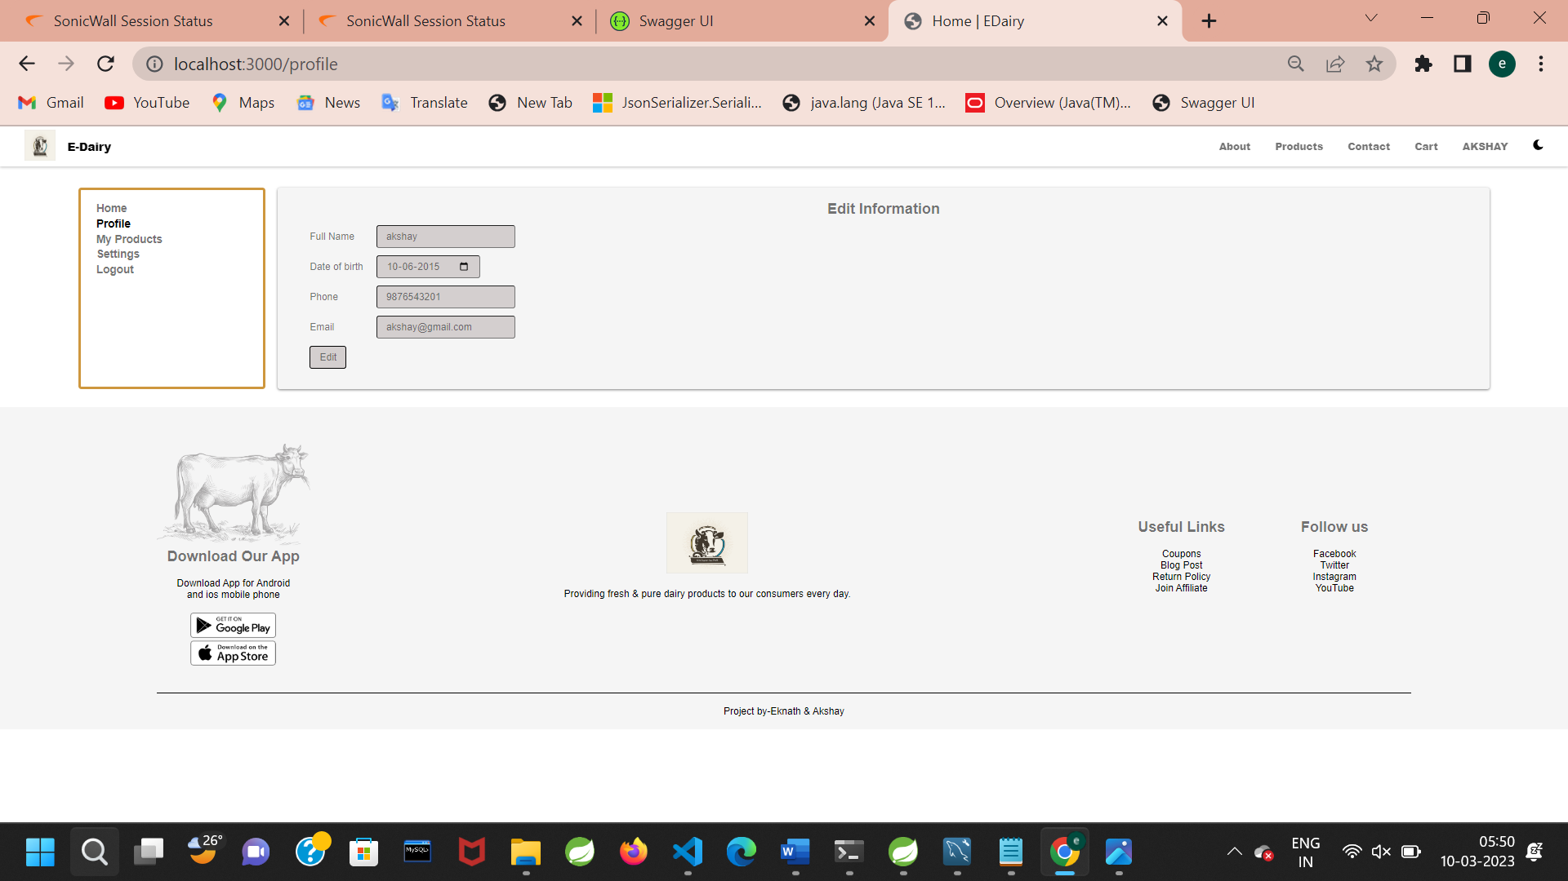

Slide 23
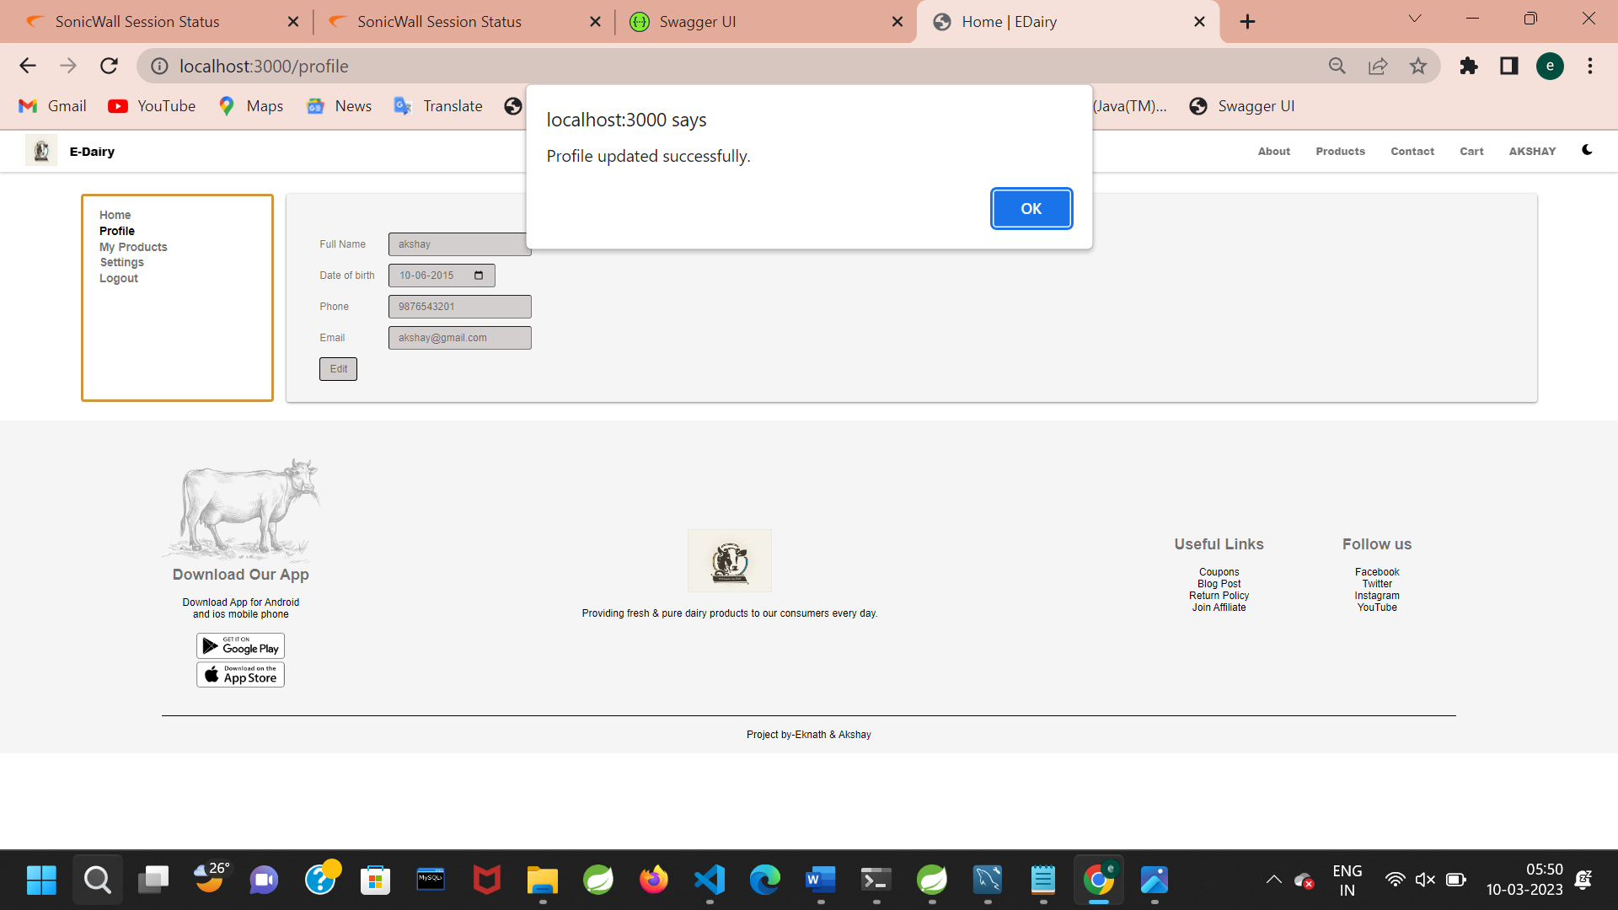

Slide 24
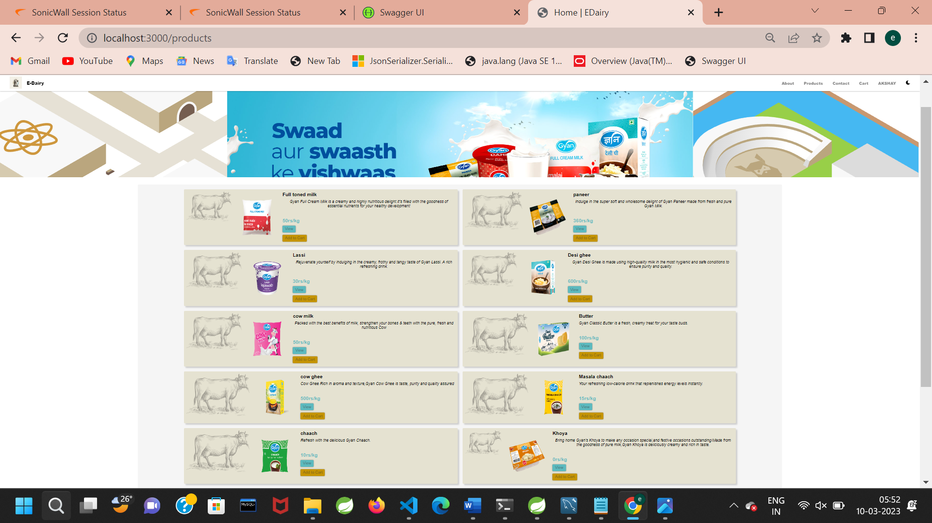

Slide 25
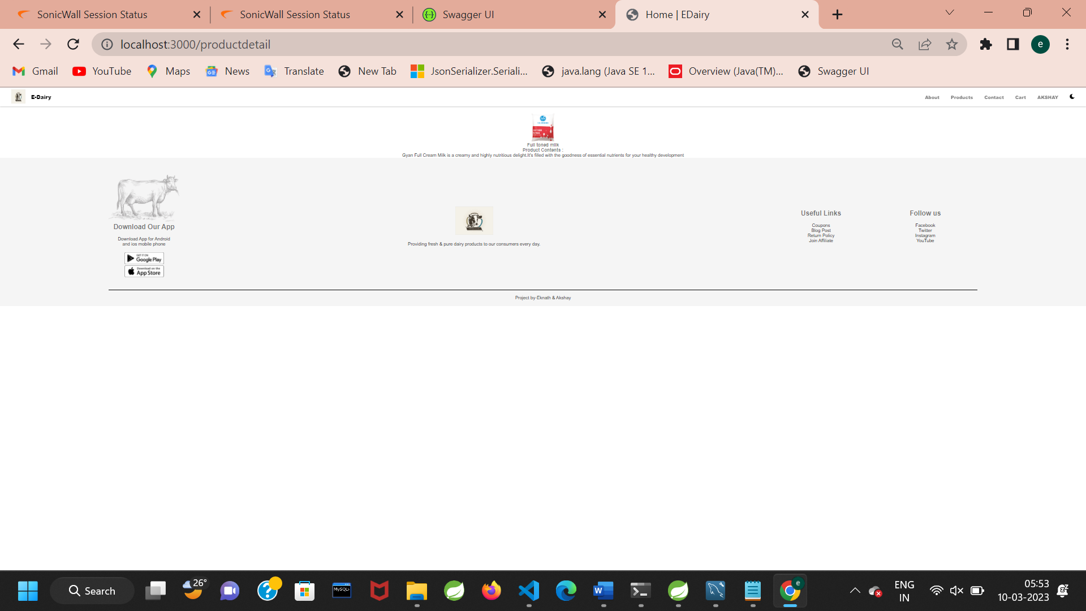

Slide 26
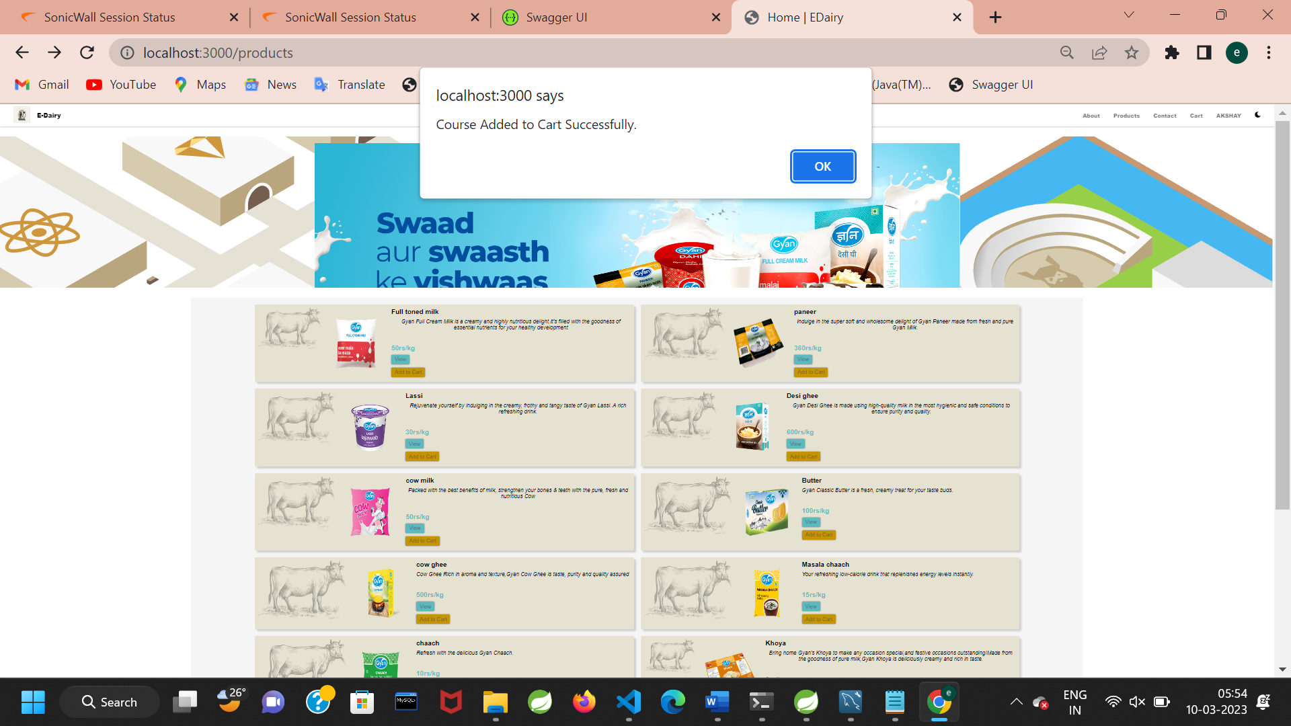

Slide 27
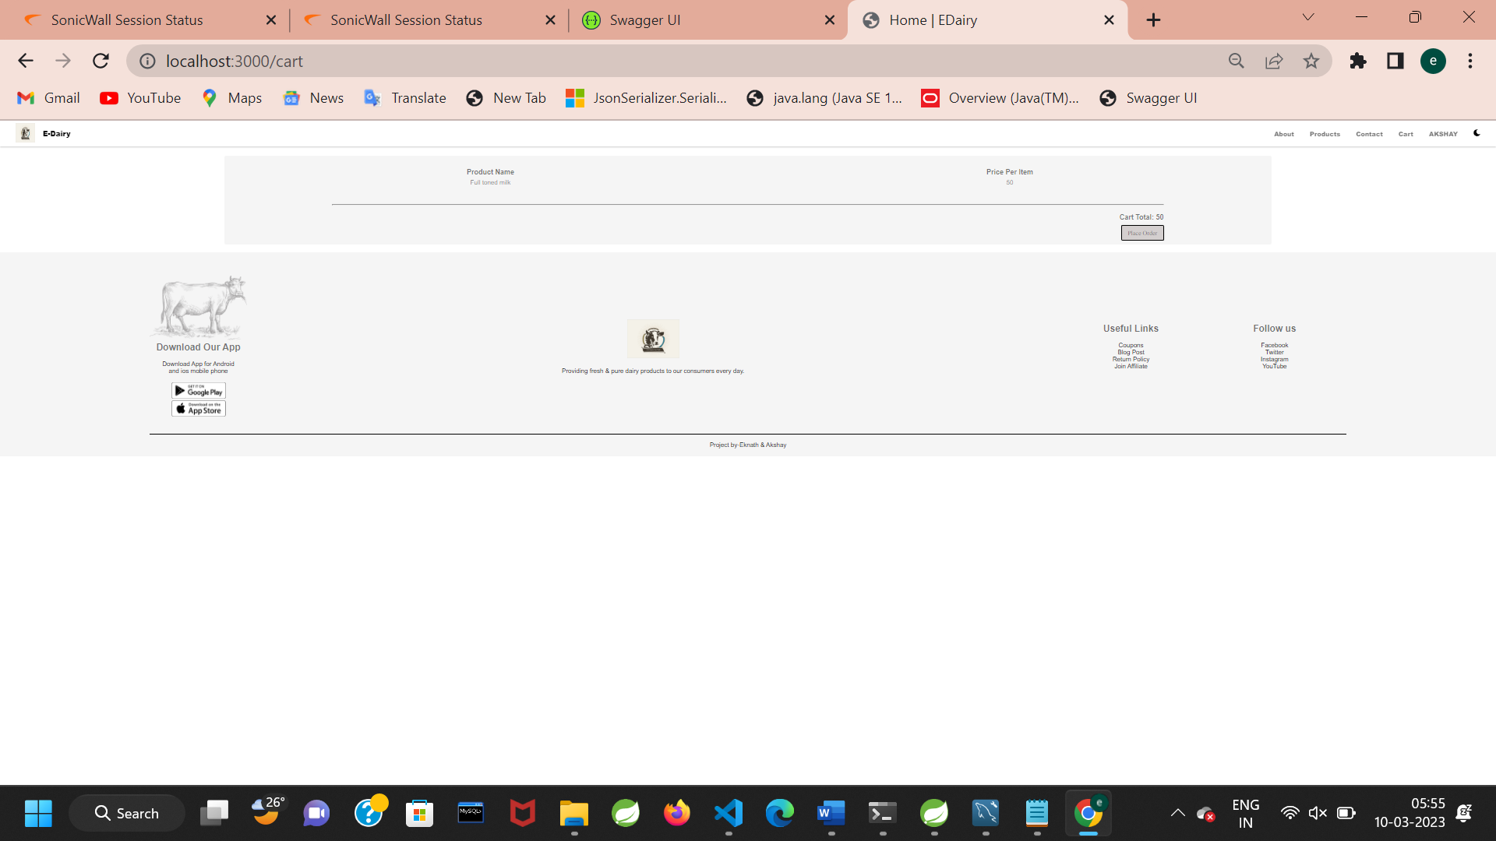

Slide 28
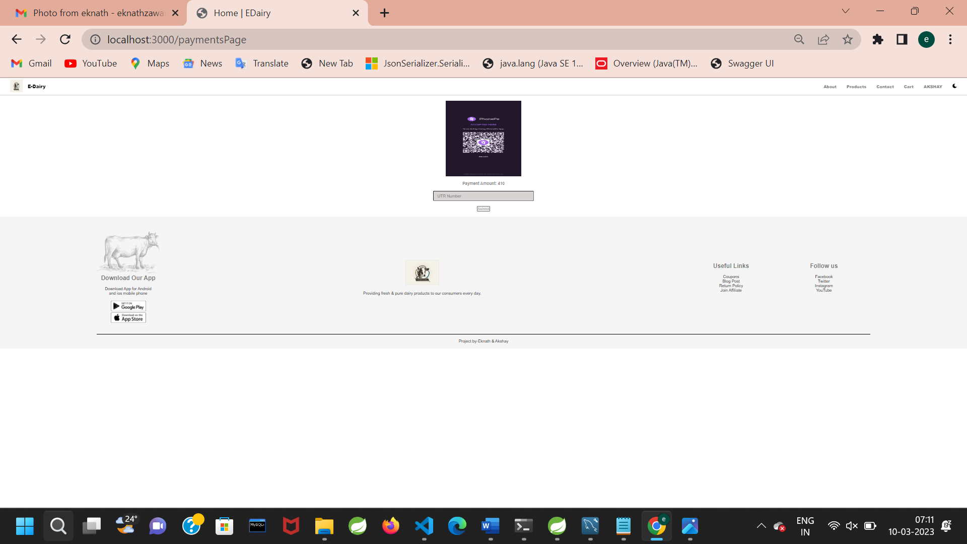

Slide 29
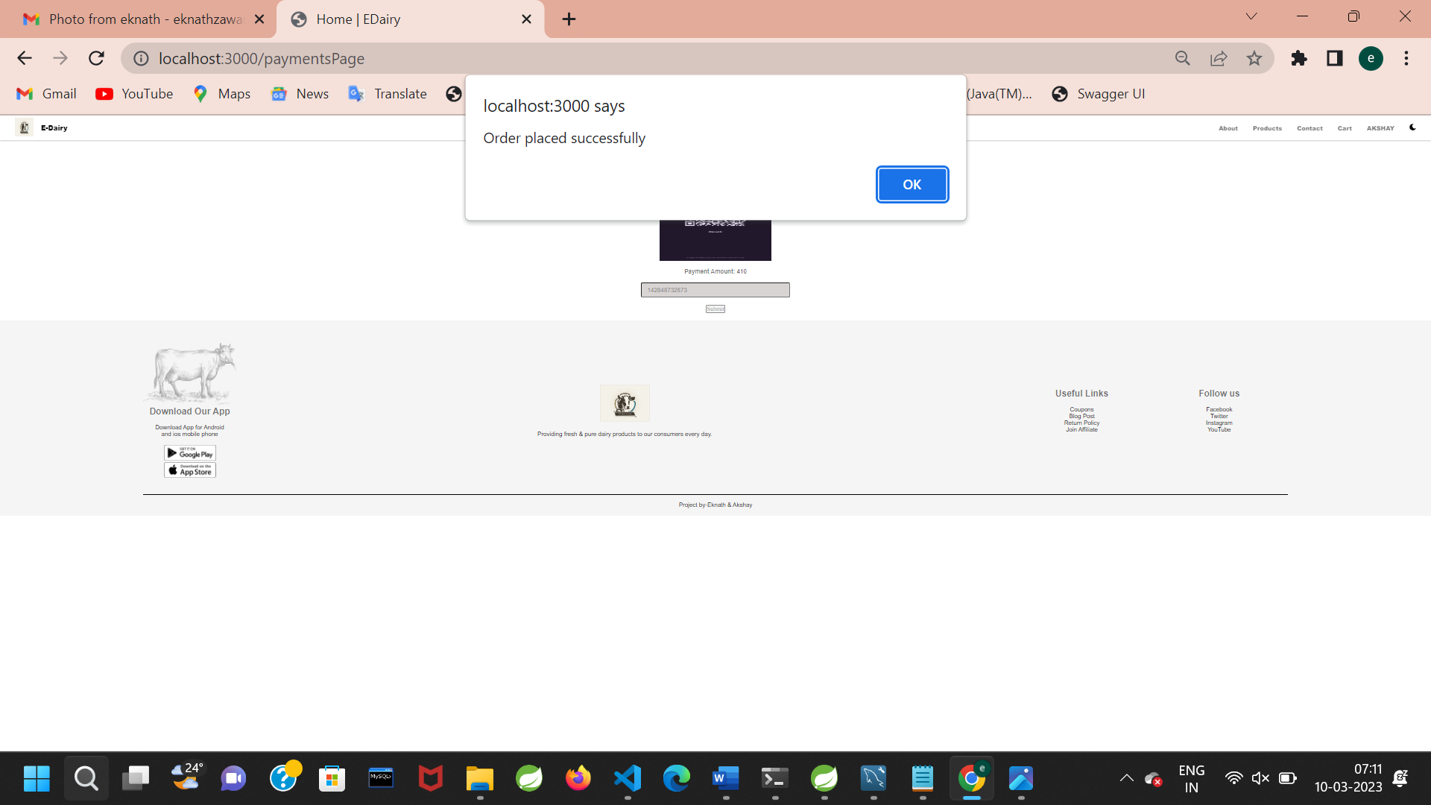

Slide 30
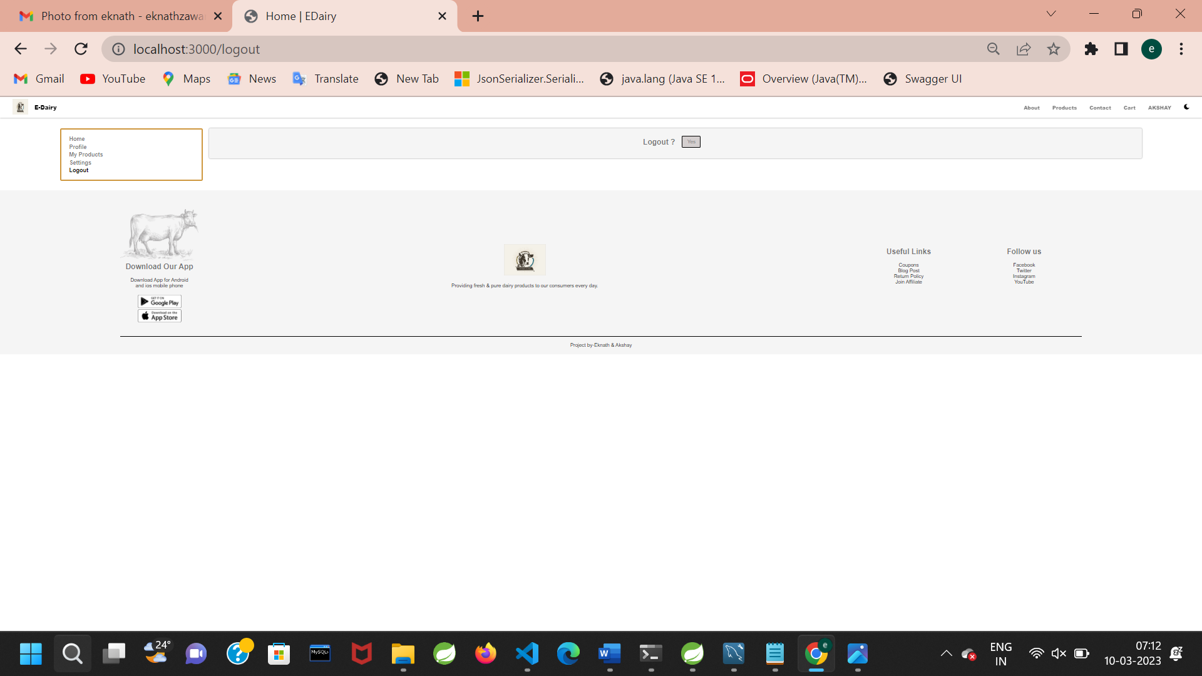

Slide 31
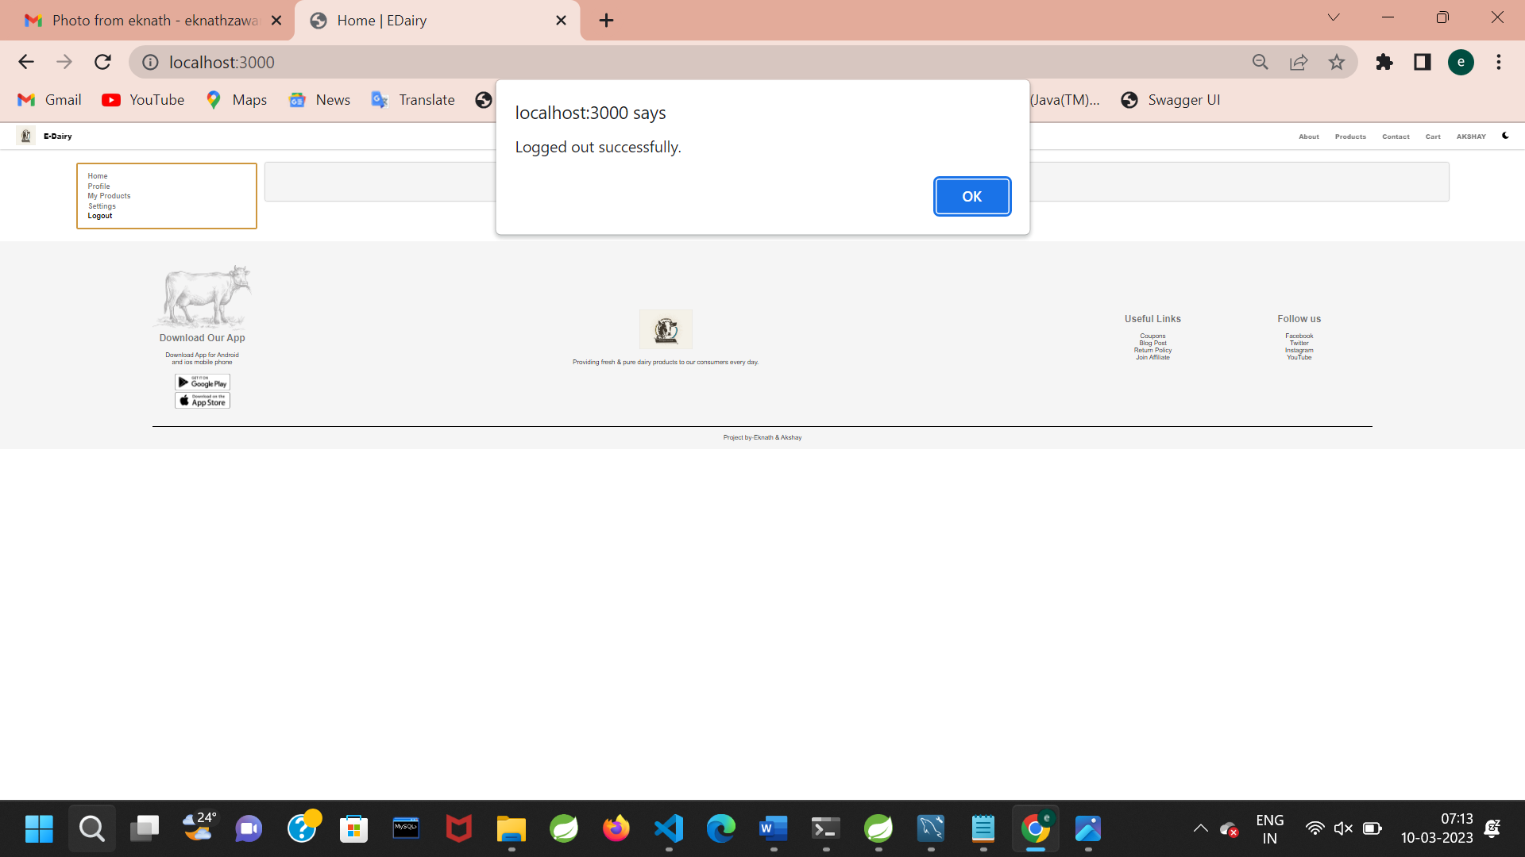

Slide 32
Futures Scope
With continual investment in advanced infrastructure, manpower and systems to better our service and extend our geographical footprint. we are pacing rapidly towards the future.
We are experimenting with new flavors and recipes, giving rise to tasty products that not only delight the taste buds but also elevate the health of our customers.
We have tried our best to present this user–friendly website to all users.

Slide 33
Conclusion
The E-dairy System project is initiative to create an online platform for any user to consume .
The E-Dairy System project is initiative to create an online platform for any user to consume the products which are available on the application.
So that they will get secure, gauranted and immediate product/help on time.
And also these products will be secure and easily available to any user.

Slide 34
References
https://docs.oracle.com/en/java/
https://docs.spring.io/spring-boot/docs/current/reference/htmlsingle/
https://dev.mysql.com/doc/
https://reactjs.org/
https://www.fssai.gov.in/

Slide 35

THANK YOU

